Slide 1

Number System Toolkit
C++ Project | Academic Year 2026–27
Team Members
Guided By
P. Nikhil — Roll No: 25B11AI913
P. Balarkananda — Roll No: 25B11AI876
R. Teja — Roll No: 25B11AIA23
V. Veerendra — Roll No: 26B21AI126
T. VIJAYA LAKSHMI Madam
(M-TECH)
Department of Artificial Intelligence & Machine Learning

Slide 2
SLIDE 2
Project Abstract
The Number System Toolkit is a console-based C++ application designed to facilitate seamless conversion of numerical values across the four primary number systems — binary, octal, decimal, and hexadecimal — that form the foundation of modern computing. The application provides an intuitive menu-driven interface that enables users to select a source base, specify a target base, and instantly obtain accurate conversions without manual computation. Beyond conversion, the toolkit implements core arithmetic operations — addition, subtraction, and multiplication — directly across different number bases, extending its utility well beyond a simple converter. As an educational and utility tool, it serves both students learning computer architecture and programmers working with low-level systems, embedded hardware, or networking protocols where multi-base literacy is essential. The project is implemented using fundamental C++ constructs including functions, loops, conditionals, and switch-case structures, making it an ideal demonstration of applied programming concepts.

Slide 3
SLIDE 3
Problem Statement
Manual conversion between number systems is a time-consuming and error-prone process, particularly in domains such as computer science education, digital electronics, networking, and memory addressing — where rapid multi-base arithmetic is a daily necessity.
Manual Conversion Delays
Low-Level Programming Needs
No Unified Tool
Fields like digital electronics and memory addressing demand constant switching between binary, octal, decimal, and hex representations.
No single, fast, offline console utility exists that combines conversion and cross-base arithmetic in a beginner-friendly C++ environment.
Students and developers waste significant time performing step-by-step base conversions by hand, increasing risk of arithmetic mistakes.

Slide 4
SLIDE 4
Objectives
1
Menu-Driven C++ Application
Design a structured, menu-driven C++ application for intuitive number system conversion accessible to users with minimal programming background.
2
Multi-Base Conversion Support
Support bidirectional conversions between Binary, Octal, Decimal, and Hexadecimal number systems covering all 12 conversion paths.
3
Cross-Base Arithmetic Operations
Implement addition, subtraction, and multiplication across different number bases with correct result formatting in the target base.
4
Input Validation & Error Handling
Validate all user inputs against permissible digit sets for each base and handle invalid entries gracefully with descriptive error messages.
5
User-Friendly Console Interface
Provide a clean, simple, and readable console interface that guides the user step-by-step through all operations without confusion.

Slide 5
SLIDE 5
Planned Modules / Functions — Overview
Input & Validation Module
Accepts user input (number string + base), checks digit validity per base, and prompts re-entry on invalid input.
Conversion Module
Handles all base-to-base conversions: Binary ↔ Octal ↔ Decimal ↔ Hexadecimal using standard mathematical algorithms.
Arithmetic Module
Performs addition, subtraction, and multiplication by routing operands through decimal intermediary and converting results back to the target base.
Display / Output Module
Formats and prints conversion results and arithmetic outputs clearly on the console, including the source and target base labels.
Menu-Driven Control Module
Acts as the program's main controller — presents options, reads user choices via switch-case, and routes execution to the appropriate module.

Slide 6
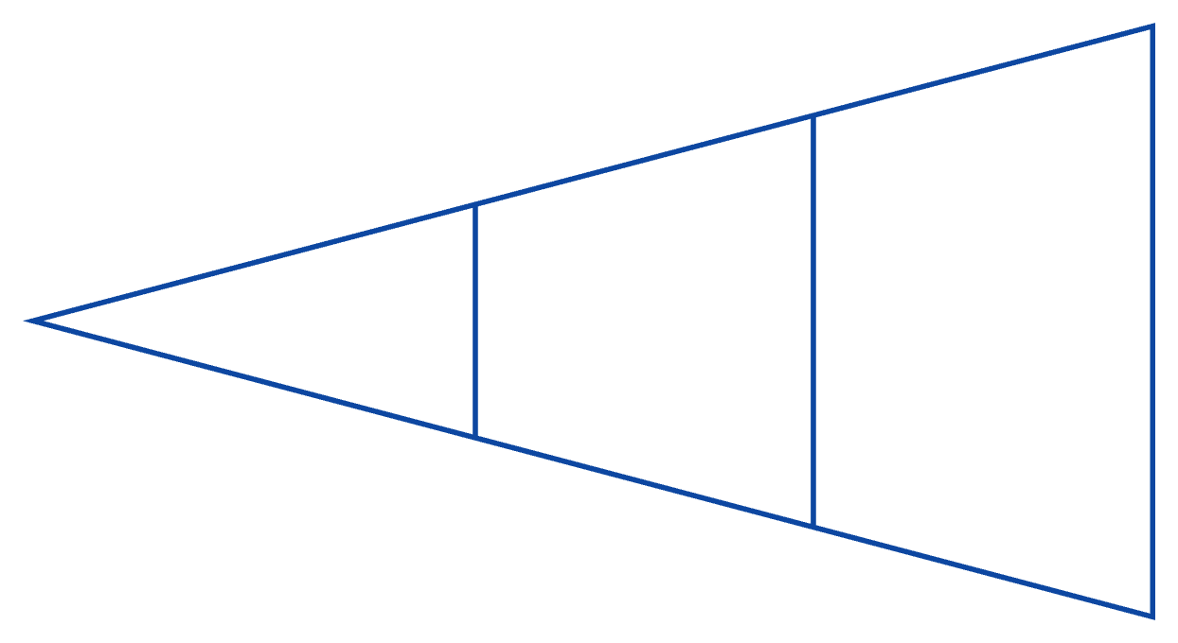
SLIDE 6
Module Details: Conversion Functions
Core Conversion Functions
General Logic Flow
binaryToDecimal()
decimalToBinary()
Traverses binary string right-to-left, multiplying each bit by its positional power of 2 and summing the products.
Repeatedly divides decimal value by 2, recording remainders in reverse to form the binary string.
Parse Input
Convert to Target Base
Convert to Decimal
decimalToOctal()
decimalToHex()
Divides by 8 iteratively, collecting remainders (0–7) to build the octal representation from least-significant digit upward.
Divides by 16, mapping remainders 10–15 to characters A–F and assembling the hex string in reverse order.

Slide 7




SLIDE 7
Module Details: Arithmetic Functions
Arithmetic across number bases is achieved by a three-phase approach: convert both operands to decimal, perform the standard operation, then convert the result back to the desired output base.
Accept Operands & Base
Convert to Decimal
User provides two numbers in their respective source bases and selects the desired output base.
Both operands are converted to decimal integers using the Conversion Module before any calculation.
Compute Result
Convert to Target Base
Standard C++ arithmetic (+, −, ×) is applied to the two decimal values, yielding a decimal result.
The decimal result is passed to the appropriate conversion function and displayed in the target base.
Supported operations: Addition · Subtraction · Multiplication — each accessible from the Arithmetic sub-menu of the main menu.

Slide 8

SLIDE 8
Inputs & Expected Outputs
I/O Structure
Input | Source Base | Target Base | Output
1010 | Binary (Base 2) | Decimal (Base 10) | 10
255 | Decimal (Base 10) | Hexadecimal (Base 16) | FF
17 | Octal (Base 8) | Binary (Base 2) | 001111
1010 + 0101 | Binary (Arithmetic) | Binary (Base 2) | 1111
1A + 05 | Hexadecimal (Arithmetic) | Decimal (Base 10) | 31
For arithmetic operations, the user provides the operation type (Add / Subtract / Multiply), both operands in their source base, and the desired output base.

Slide 9
SLIDE 9
Algorithm
01
02
Start
Display Main Menu
Initialize the program and display a welcome banner with project and team information.
Show options: (1) Conversion, (2) Arithmetic Operations, (3) Exit. Read user choice via switch-case.
03
04
Accept Number & Base(s)
Validate Input
Prompt user to enter the number string, source base, and target base (or operation type for arithmetic).
Check each digit against the permissible character set for the given base. On failure, display error and re-prompt.
05
06
Perform Conversion / Arithmetic
Display Result
Call the appropriate module function(s). For arithmetic, convert → compute → convert back.
Print the input, the operation performed, and the final result clearly labeled with its base.
07
Repeat or Exit
Ask user if they wish to perform another operation. If yes, return to Step 2; otherwise terminate program.

Slide 10
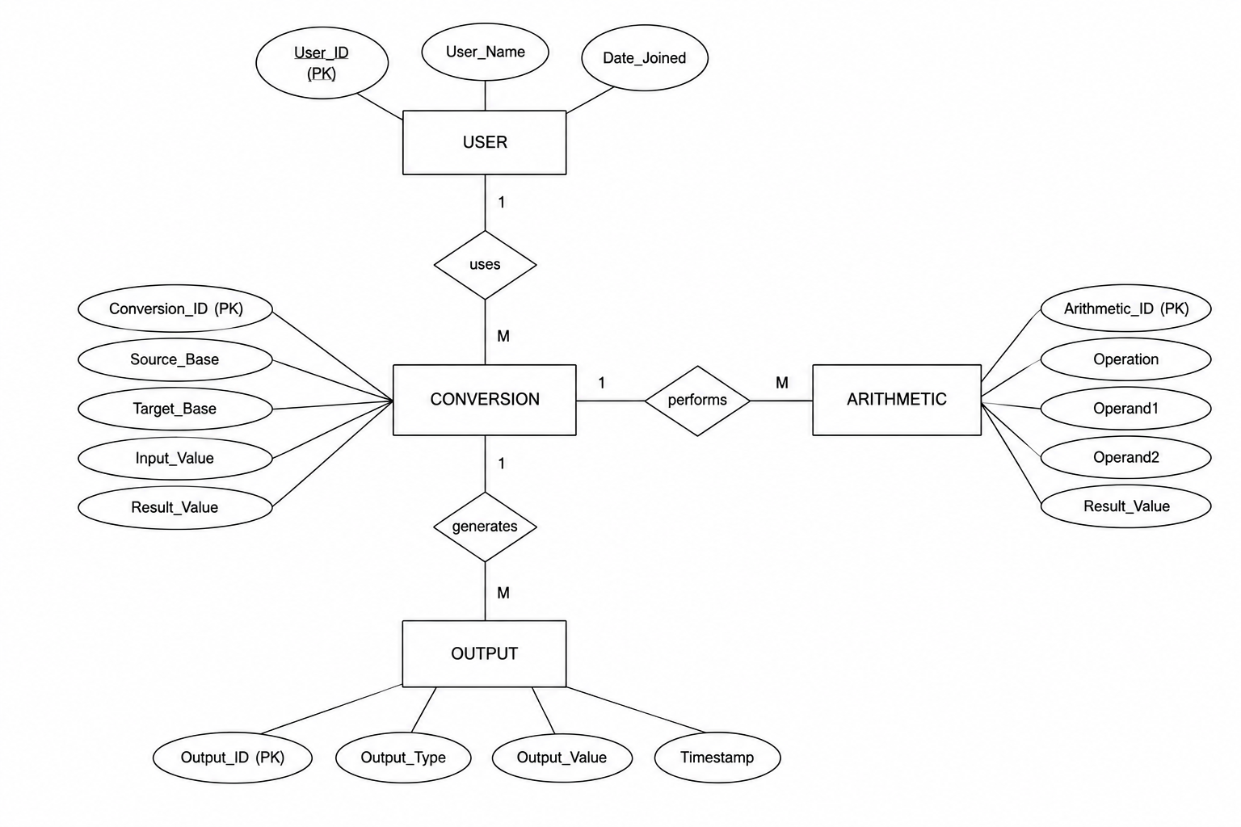

Slide 11
THANK YOU

